Slide 1

“Autonomous Indoor Drone – Round 3”
Team Name : Orbit
Institute Name : KIET Group of Institutions, Ghaziabad

Slide 2

Team member details
Team Name | Orbit
Institute Name | KIET Group of Institutions, Ghaziabad
Team Members > | 1 (Leader) | 2 | 3
Name | Md. Aanis Noor | Pravesh Narayan Soni | Prateek Gupta
Batch | 2022 | 2022 | 2022
Area of expertise | +Project Planning +Software testing/debugging +Computer Vision | +Embedded firmware +Hardware +Drone tech | +AI training +Software coding +Simulation
Achievements/ Participations/ Experience/ Works | + Participated in Dronathon (by Uttarakhand Govt.) + Stood 2nd in DTMF controlled robot picking race by TechShiksha coaching institute. + Built a DTMF-call-only controlled UAV drone for college Technical Fest from scratch. + Worked/built 3+ UAV drones. + Worked on Arduino, linux, raspberry-pi. | + Made 10+ motherboards (ARM) & some MEMS modules as well. + Participated in Dronathon (by Uttarakhand Govt.) + Worked on RTOS firmwares for ARM microcontrollers. + Made 10+ UAV drones. + Made own working flight controller from scratch and its software as well. + Conducted a drone race in college. Repository: https://github.com/Elvez?tab=repositories | + Made smart glasses as an independent project + Worked on ‘my parliament’ app for Innovation Centre robot management + Participated in Smart India Hackathon

Slide 3
Drone specifications
Frame model / Material | Mini 290 (Carbon Fiber)
Frame wheelbase (mm) | 290
Frame arm size (mm) | 125 x 25 (L x W)
Multi-copter type | Hexacopter
ESC category | 15A
Motor rating | 2300kV BLDC
Propeller rating | 6” 6030
Flight Controller | DJI Naza M-lite
Battery | 3300mAh LiPO battery 3S
Claw servo | M-995 10kg Servo
Compass Module | HMC5883L
Master microcontroller | STM32F103C8
Camera for obstacle detection | Pixy2cam
IR Sensor for obstacle avoidance | Sharp GP2D12
RxTx | Radiolink R12DS pair
WiFi Tx for Camera | ESP826
Barometer / Altimeter | MS5611

Slide 4
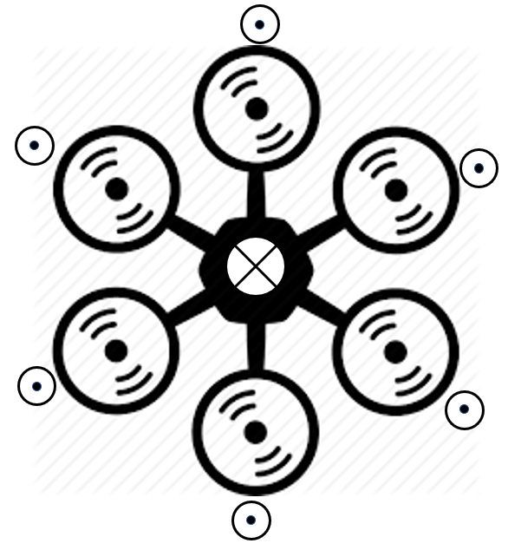
Payload Calculation
Thrust vector – max 1024gm for each motor
Payload vector – 6kg capacity (As centered as possible)
Overall weight of drone with components (excluding payload) = 1,434gm
Maximum thrust capacity left = 4,566gm
By applying environmental filter for NTP and wind = 4,300gm
Finally applying flying filter of (6.018:1) according to NTP and clear weather assumption = 2,300gm
Hence for comfortable flying, the capacity of the drone is 2,300gm payload weight

Slide 5
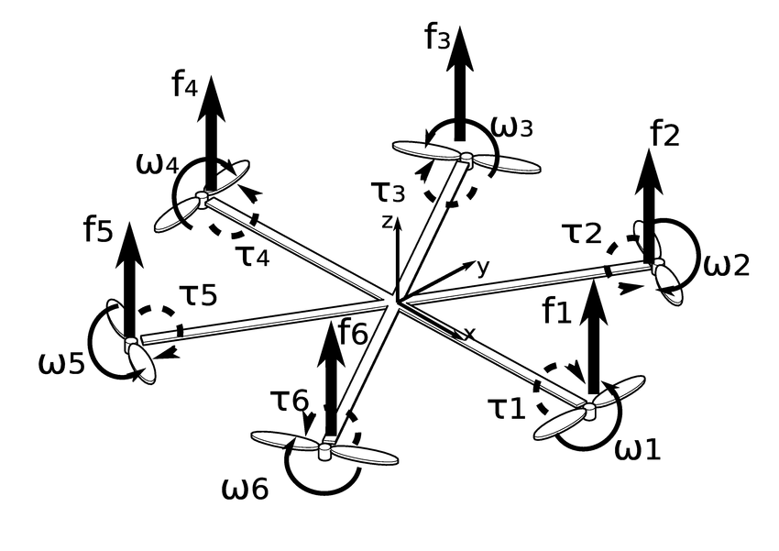
ω – Angular Momentum
τ – Torque
F – Thrust
Diagram : Various mathematical components of the hexacopter UAV

Slide 6
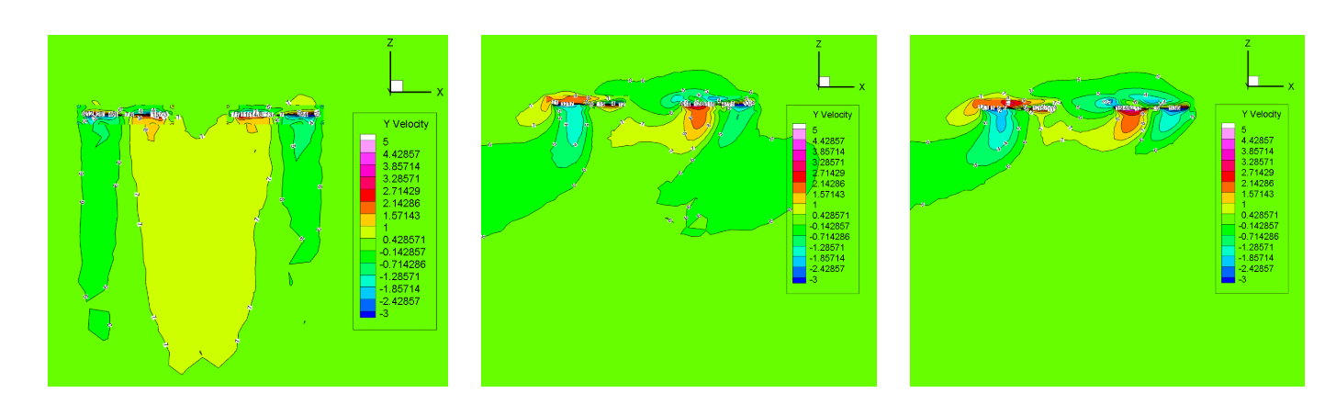
Aerodynamics
The velocity contour between the rotors with the influence of horizontal airflow is shown :
(a) 0 m/s (b) 2.5 m/s (c) 4 m/s

Slide 7
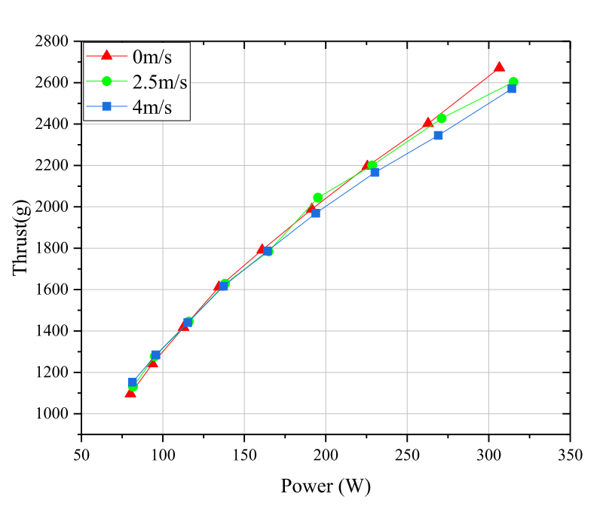
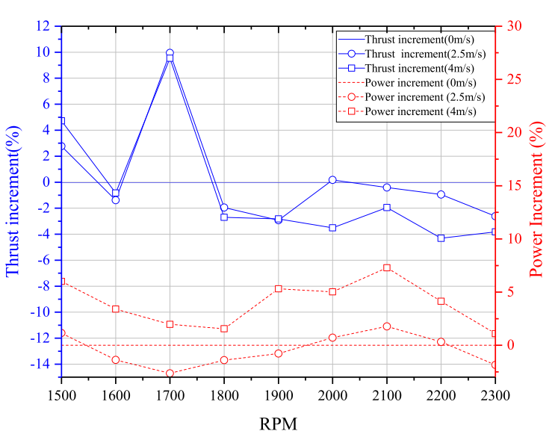
From an earlier made hexacopter, these were the results of experimental analysis using attached sensors :
Graph(1): Thrust and power consumption with different wind speeds.
Graph(2): Thrust and power increment at different speeds.

Slide 8
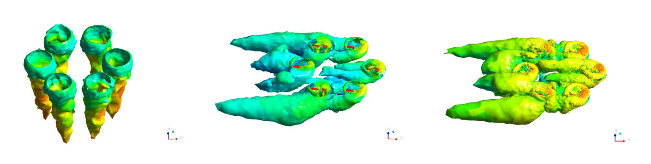
Vortex distribution of Hexacopter UAV at different horizontal speeds
(a) 0 m/s (b) 2.5 m/s (c) 4 m/s

Slide 9
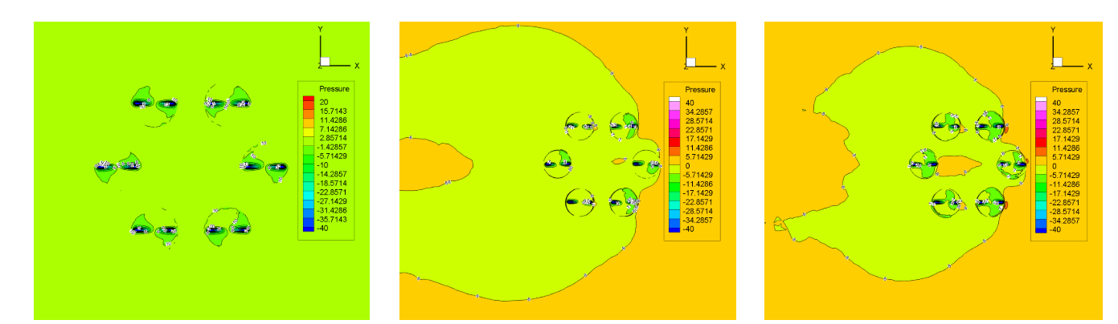
Pressure distribution on the plane upper 10 mm of the center of the Hexacopter UAV
(a) 0 m/s (b) 2.5 m/s (c) 4 m/s

Slide 10
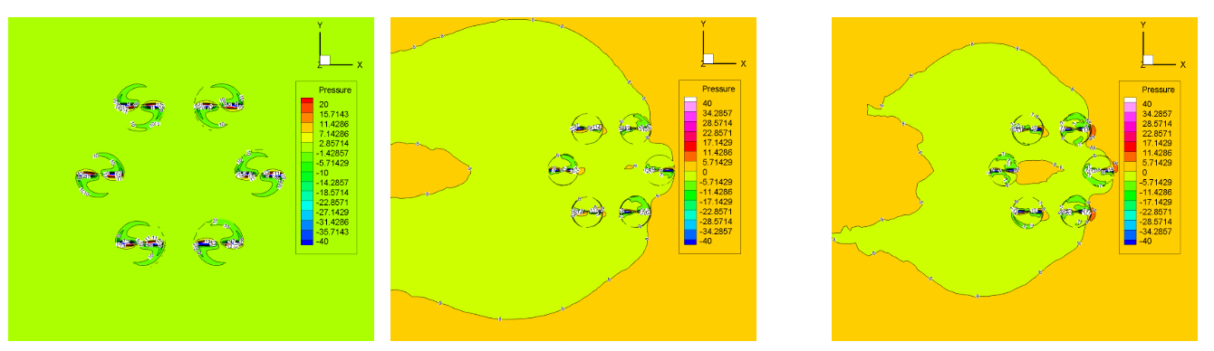
Pressure distribution on the center plane of the Hex-rotor UAV
(a) 0 m/s (b) 2.5 m/s (c) 4 m/s

Slide 11
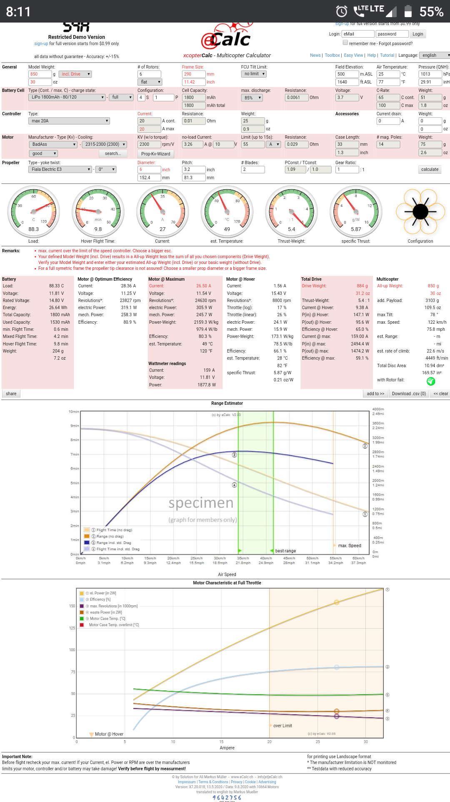
Performance Statistics
Computed using xCopter : https://www.ecalc.ch/xcoptercalc.php?ecalc&lang=en (continued…)

Slide 13
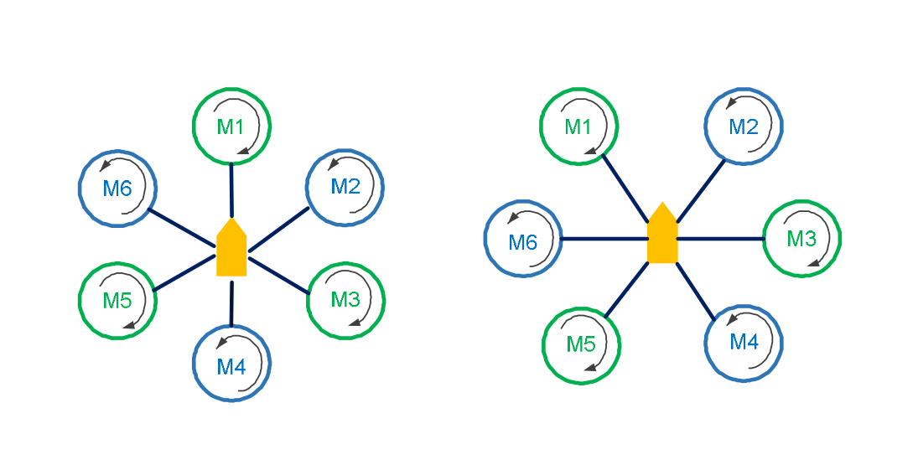
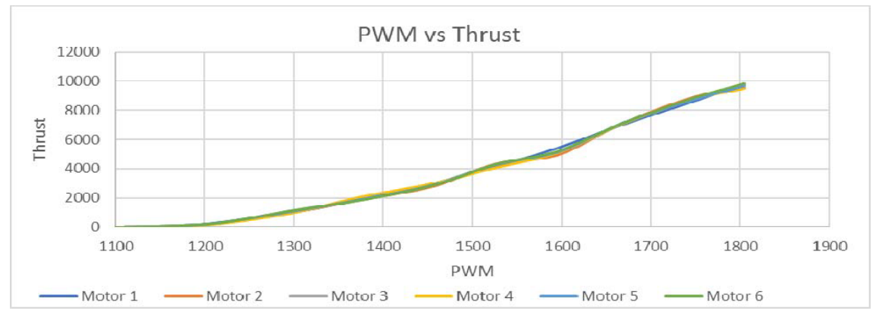

Structural & Stability Analysis (with & without payload)
Hexacopter configuration –
thrust = $\frac{total weight X 2 }{number of motors}$

Slide 14
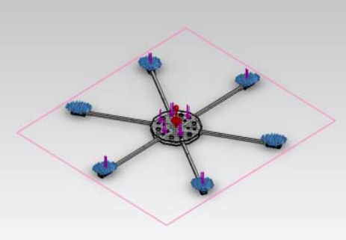
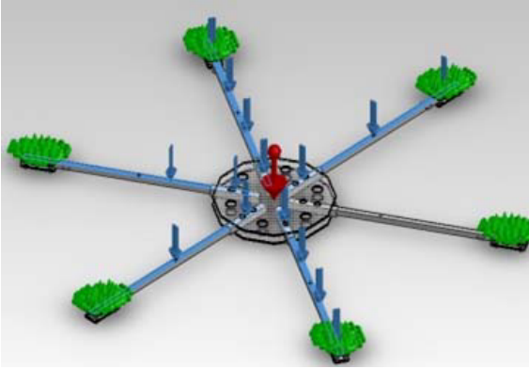
Note: We showcase a hexacopter made earlier with more realistic assumptions and simulation.
The Hexacopter frame consist of ABS material for its strength and lightweight characteristics.
Furthermore, a loading simulation of this frame will be done by analyzing the static and dynamic materials. The force that is given as the load on this simulation is 50 N (more than required for better understanding of stress).
Hexacopter ABS frame design
Placement of styles on the frame

Slide 15
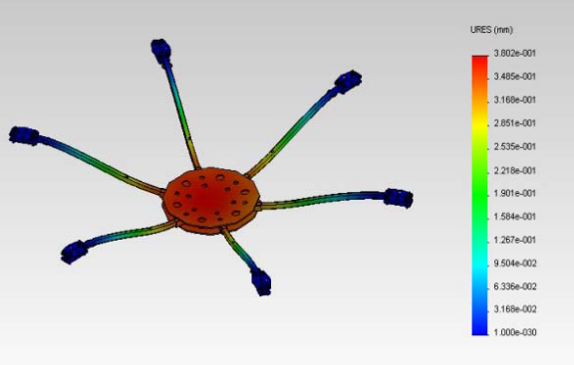
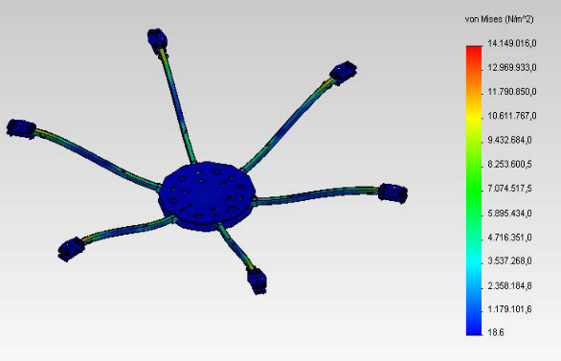
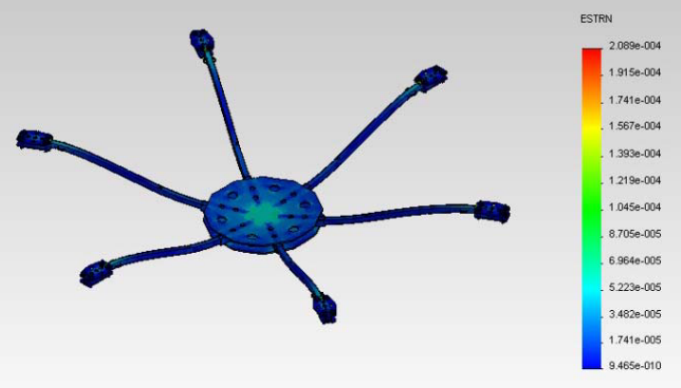
The displacement analysis on the frame
Stress analysis on frames
Strain analysis on the frame

Slide 16
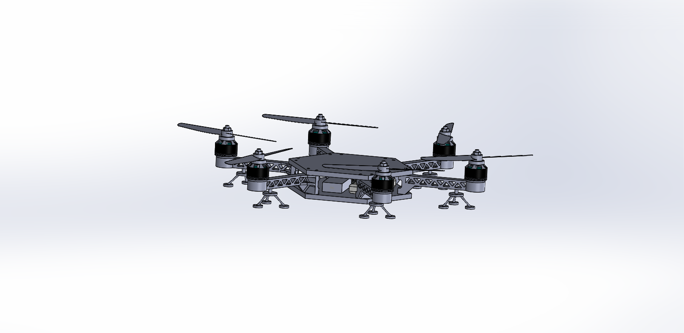
CAD File with Payload & Drone Components
CAD File - https://drive.google.com/file/d/1TjKUJIND-tie4K79vyENH-ALdE3wVsSZ/view?usp=sharing
CAD File (gripper) - https://drive.google.com/file/d/1OpdvWDvvScgcSHJvw-XqJ5o8-uEJ5rBZ/view?usp=sharing
CAD zip (with part files)- https://drive.google.com/file/d/1H6qdqrtN59HDinxw74zl31VKuelBhMW4/view?usp=sharing
Hexacopter CAD file (snapshot)

Slide 17
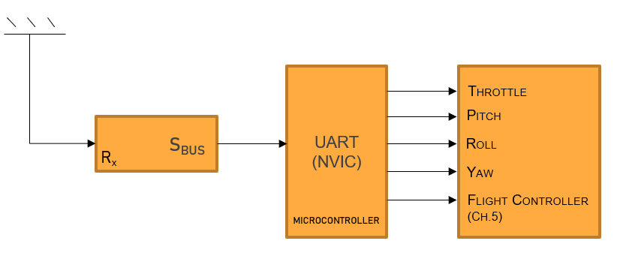
Autonomous Flight Algorithm Details
Basic working principle:
A typical UAV drone is controlled mainly using the Flight Controller with manual PWM inputs.
But what we do is - Instead of connecting the receiver to the flight controller, we connect it to a micro-controller first and then use the global interrupt on the chip to drive the PWM connections on the flight controller by TIM1_CH1, channel 2, 3, 4 and TIM2 (if we need).
‘TIM’ is the TIMER peripheral of the microcontroller.
We call this process “Receiver Hijack Protocol (RHP) ”
Technically, instead of manually providing PWM via Tx, we embed the algorithm into the micro-controller (master) which then instructs the Flight Controller (slave) as dummy Rx/Tx.
(Refer to image on next page)
Video explaining RHP - https://drive.google.com/file/d/1nrVtzBPOb7A1DopLgrXx-qB41DZE8kKL/view?usp=sharing

Slide 18
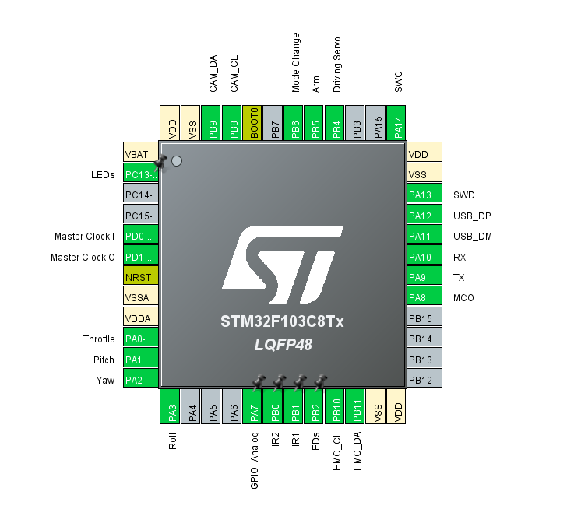
Reference: STM32 Microcontroller Pin Layout

Slide 19
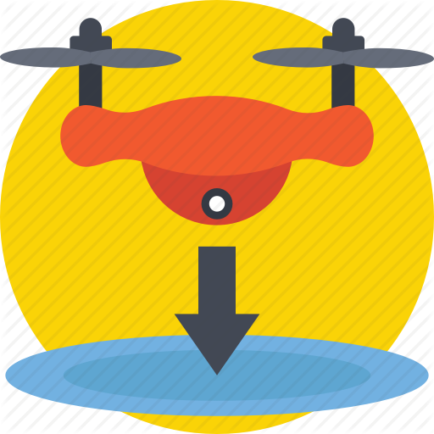
i) Take off and landing logic
Nutshell:
The height for the given task is constant and pre-defined. We use an altimetric/barometric sensor to fix the height from the point of flight for take-off. Further to this, the flight and frame detection algorithms kick in.
The final point of landing would be given a QR Code (printed image) which will be read by drone’s AI-camera module; this determines the point of landing. The UAV will go stable approximately above this point, and the throttle will be lowered down until the UAV drone is on ground.
(continued…)

Slide 20
Take off Logic
Landing Logic
Step ( 1 )
Power ON
Arm Motors
Step ( 2 )
Throttle Up
Step ( 3 )
if (altitude == definedHeight) : func(holdThisAltitude)
Fix Position on Land
Wait for Altimeter Data
Step ( 0 )
Step ( 1 )
Step ( 2 )
Search for gates
Open servo to drop item (after throttle down)
if (numberOfGates == None) : GoTo Step ( 1 )
Lurk & Look for a matching QR Code (through camera module)
Associate a QR code to landing function
if (foundQrCode == 1) : GoTo Step ( 2 )
Lower down throttle until UAV touches the ground.

Slide 21
Extended : “Drop Mechanism & Landing”
{
repeat_process( ); //until signature = 0
}
//payload
{
if (QrRead == wantedNumber)
{ writeServo(fullAngle); //dropPayload }
}
{
Land( );
Disarm( );
}

Slide 22
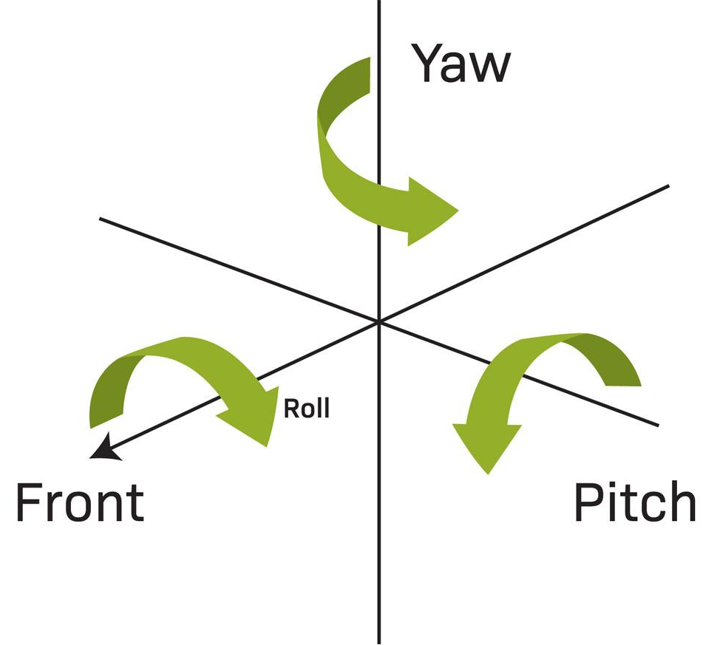
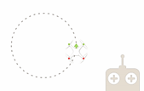
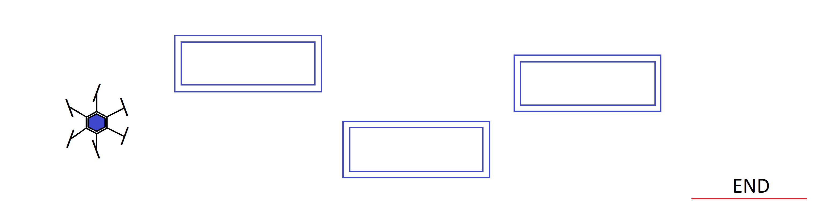
ii) Flight algorithm
Nutshell:
For the process of moving the drone automated, we first create a dataset by manually controlling it via PWM inputs of a transmitter; and then writing it into a file.
We make functions for every movement of the drone via these experimental inputs.
Finally, we apply the frame detection algorithm to automate drone movement in the environment.
(continued…)
Use Transmitter to move drone
in complex geometries
Write PWM data via interrupted UART
(into a text file)
Apply frame detection logic to automate
Drone movement as required
RHP &Training

Slide 23
The dataset generation process:
We use the transmitter to move the drone in complex geometries like turning, circling, quarter circling, etc.
As the R_{x} gives data to the interrupted UART –
{
HAL_UART_Receive_IT (&huart1, (uint16_t)pwm, 2, 10);
}
//&huart1 is a TypeDef to the HAL (Hardware Application Layer) peripheral of UART
//16-bit SBUS PWM data is received in “pwm’, two bytes are received with a timeout of 10ms
{
WriteToFile(pwm, File.txt);
}
Through this process, we assume that we’ve generated these four basic functions (used for flight):
1. moveForward(time); moveBackwards(time);
2. moveLeft(time); moveRight(time);
3. turnClockwise(angle);
4. turnAnticlockwise(angle); (continued…)

Slide 24
Memory Allocated : 5kB
Scheduler : Pre-emptive
Semaphores :
1 semaphore of 5 count
Number of tasks : 5
Dataset completion time: 3 days
After we have the dataset, we proceed to make the code that allows us to move the drone as we simply like, according to the requirements.
RTOS Block for Dataset Generation

Slide 25
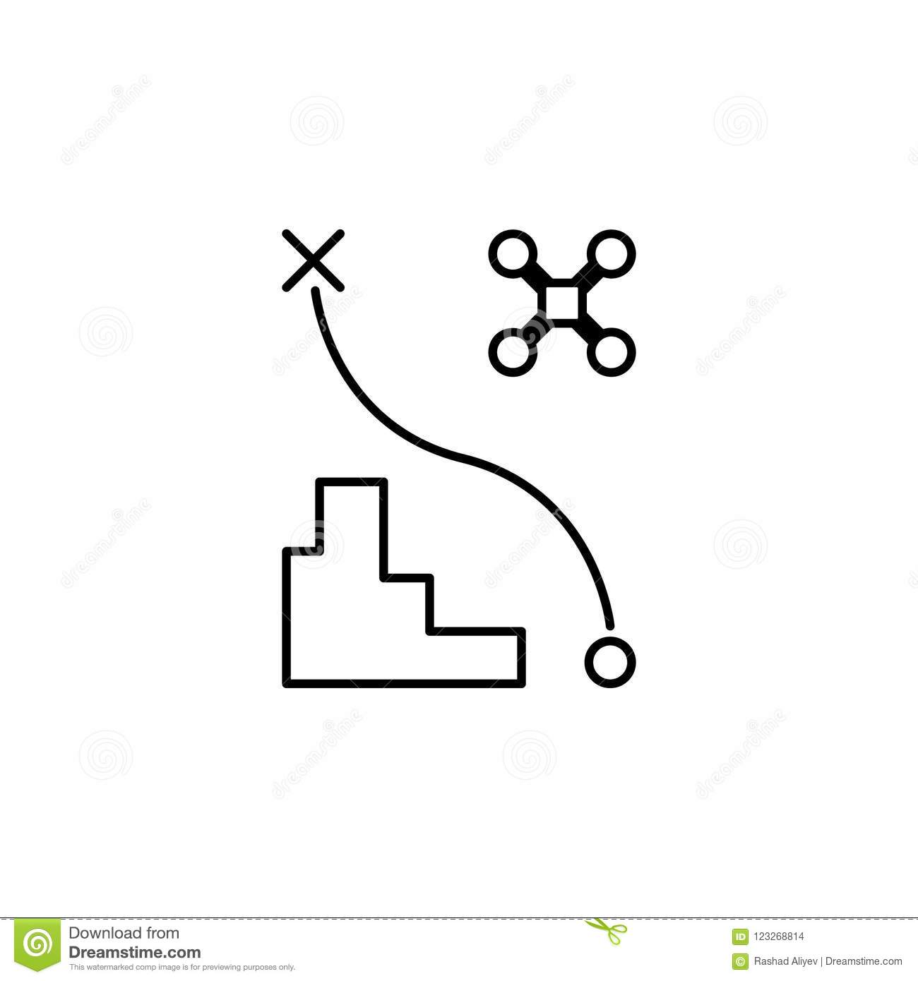
iii) Trip management
After successful take off, we go through the following steps for trip management :
Gathering data from the AI-Cam
Correction Algorithm
Find center of the corresponding gate & Alignment Algorithm
IR PID loop to avoid collision while passing through gates
(continued…)

Slide 26
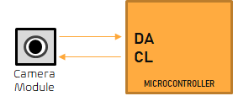
Gathering data from the AI-Cam
* Address – 0xAE
The 16-bit ASCII return packet from pixy2cam contains all the info we need.
* Packet – { Rank ; Signature ; Vector X,Y ; Dimension(P_{x} ) ; Age… }
* We only need the first 4 elements of the packet, so we move on to the correction algorithm…

Slide 27
B. Correction Algorithm
(PID loop 1)
To extract only the first 4 elements (pseudo code) –
do {
camData[count] = camData[count] << 8 ; //I2C data read and store
camData[count+1] = camData[count+1] << 8 ; //I2C data read and store
}
while {
camData[count+3]
}
The execution of above will leave us with only the first 4 elements which are required (from 8 elements)
Input data from the pixy2 AI camera
module
Bit shift 8 bits (of 16 bits) to retain required
data only
Apply logic to the acquired data for further processes

Slide 28
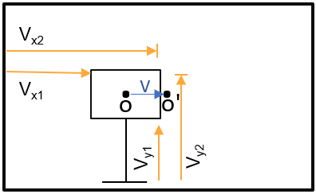
C. Find center of the corresponding gate & alignment
The vector X, Y read from I2C gives 4 vectors;
L = \ V_{x1} - V_{x2} |
B = \ V_{y1} - V_{y2} |
O => Center of Gate
O’ => Center of Screen (known by default)
For O,
O_{x} = [ ( V_{x2} – V_{x1} ) / 2 ] + V_{x1} ;
O_{y} = [ ( V_{y2} – V_{y1} ) / 2 ] + V_{y1} ;
O = (O_{x} , O_{y})
Now drawing a vector from O to O’ through vector register (0xC20158) in pixy2
V => Vector between O and O’

Slide 29
Through the process below, the drone is centered according to the gate in front of it.
while (L:B == designatedRatio)
{
PID( ); //using vector V plotted earlier
}
{
error = LV_{c} ;
P = K_{p} * (L_{v} – L_{c}) //L_{v} is needed length of vector (O)
//L_{vc} is the current length
while(L_{vc} < 3) //very small error
{
I = K_{I} * (L_{vc}) + I ; //Integral
}
D = K_{D} * (L_{vc} – L_{vc1}) //currentError-previousError
PID = P+I+D ; //actively uses move functions
All we need to do after this is
{ moveFowrward(time) } //time=> delayUntilSignature = Signature-1
//signature getting reduced means there’s one less gate in sight
After this process, IR PID kicks in.

Slide 30
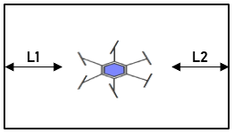
D. IR PID loop to avoid collision while passing through gates
While the drone goes inside the gates, the InfraRed sensor module gives data for PID correction of the drone to avoid any collision within the frame.
Interrupt of semaphore when drone is inside the gate :
The IR sensor reads along values…
We know that, Length_{gate} = 1000mm
Height_{gate} = 500mm
Diameter_{drone} = 290mm
So,
1000mm – 290mm = 710mm
Hence,
L1 = L2 = 710/2 = 355mm (for best results of centering inside gate)
(continued…)

Slide 31
IR PID loop:
{
P = K_{p} * (355 – L₁) ;
while (L₁<3 || L₁<5)
{
I = (K_{i} * L₁) + I ;
}
D = K_{D} * (L₁ – L_{1prev}) ; //current-previous error
PID = P+I+D ; //Actively uses more functions
}

Slide 32
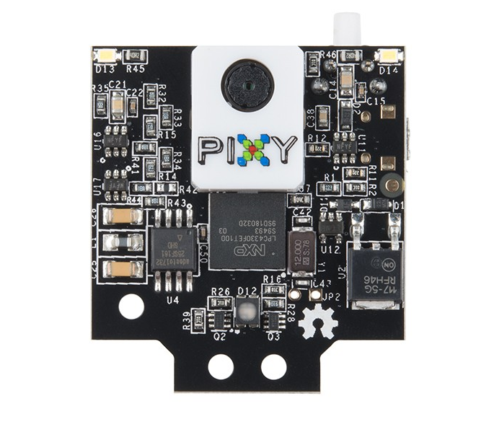

Frame Detection Algorithm Details
By knowledge, L:B ratio is same for all gates & provided colour is ‘RAL1023’
This makes us not worry about other similar looking gates.
We grab image data as explained in Slide 17
We centre the drone as explained in Slide 18/19
We adjust drone inside frame using IR PID as explained in Slide 20/21
All this was done after the frame was detected.
For frame detection, we use pixy2cam (camera) AI module available after-market.
Provided frame dimensions were fixed. In figures:
Length_{gate} = 1000mm
Height_{gate} = 500mm
The Length:Height ratio is fixed as 2:1 (or 2.00 as float)
Given frame colour - RAL1023
“We use this ratio and colour ‘RAL1023’ to train the AI camera module for detecting frames on-the-go using in-built operations.”
pixy2cam module

Slide 33
Rank : Assigned number to multiple same objects in sight or off sight.
Gates in sight are given ranks by the AI cam. We call them as signature.
The drone will keep looking for gates unless no gate is in sight.
while(framesInSight != 0)
{ signature = signature-1 }
When the frame are no more in sight and (signature == 0):
Execute(landing_procedure)
Reference: https://www.youtube.com/watch?v=EcCbEWiyiQY

Slide 34
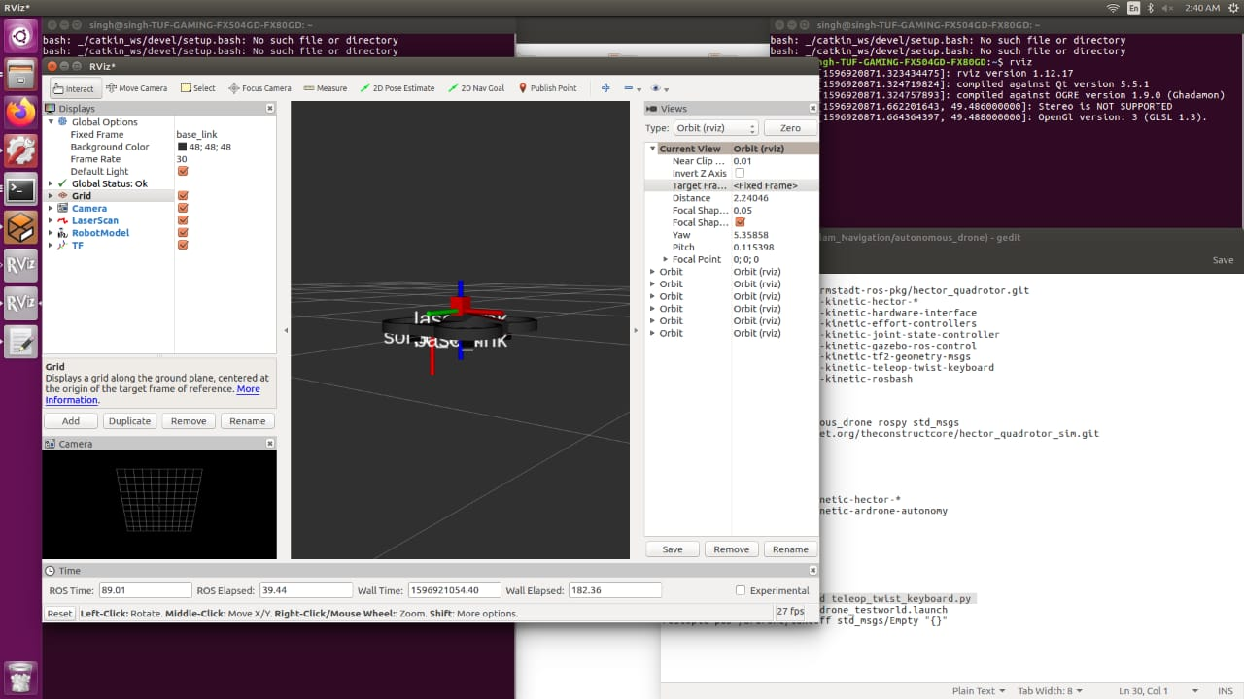
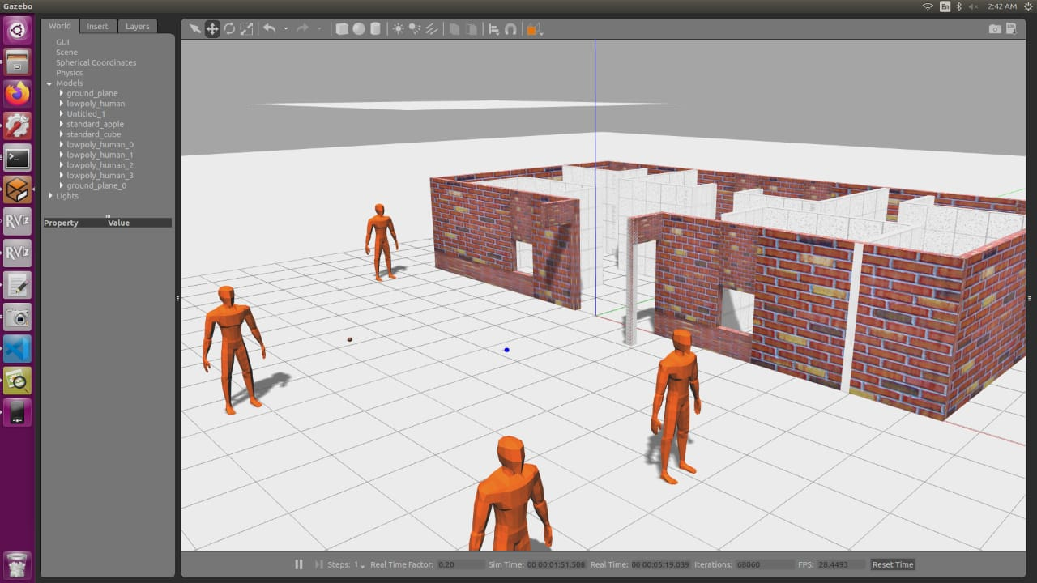
Gazebo Simulation & Assumptions
Gazebo Simulation Resources : https://drive.google.com/drive/folders/1cQmLsdZa3bAO2rOxepxtQAlwnBhihTJf?usp=sharing
We’ve provided the link to resources (in use and development).
Unfortunately for us, Gazebo simulation was incomplete due to unfortunate events with our teammate’s family. We were not able to meet this requirement within the deadline.

Slide 35
Component Sources, Price & total cost
Compass/Magnetomemter HMC5883L | ₹370/- | https://robu.in/product/gy-273-hmc5883l-3-axis-module-magnetic-field-sensor/
Barometer MS5611 | ₹900/- | https://robu.in/product/gy-63-ms5611-01ba03-high-precision-pressure-sensor-height-sensor-module/
IR Sensor x2 (sharp GP2Y0A41SK0F) | ₹1200/- (600x2) | https://robu.in/product/sharp-ir-distance-measuring-sensor-unit-4-30-cm-cable/
Motors 2300kv x6 | ₹4500/- (750x6) | https://robu.in/product/rs2205-2300kv-cw-brushless-motor-fpv-racing-quad-motor-fpv-multicopter-qav250-qav300/
6" Propeller Pairs (CW+CCW) x 3 | ₹900/- | https://robu.in (or local market)
1500 mAh LiPO battery Orane | ₹2800/- | https://robu.in/product/orange-1500mah-4s-100c200c-lithium-polymer-battery-pack-lipo/
15A ESC x6 | ₹3000/- (500x6) | https://www.roboelements.com/product/30a-esc-brushless-bldc-motor-electronic-speed-controller-for-quadcopter/?gclid=Cj0KCQjwvb75BRD1ARIsAP6LcqsZredyqG3bi0cnp8qZr1oxryIL_Wqly5hLrXrpgqNPt85X168MTLkaAiiSEALw_wcB
Carbon Fibre Drone Printing | ₹4000/- | https://robu.in
Pixy2 Camera | ₹7300/- | https://robu.in/product/pixy-1-0-smart-vision-sensor-object-tracking-camera/
Master Microcontroller | ₹500/- | https://robu.in/product/stm32f103c8t6-minimum-system-board-microcomputer-stm32-arm-core-board/
10kg Servo Motor | ₹500/- | https://robu.in/product/towerpro-mg945-digital-high-speed-servo-motor-standard-quality/
flight controller | - Own - | -
Receiver and Transmitter | - Own - | -
WiFi Tx for camera | ₹2000/- | https://robu.in
Reflective balls for motion capture training (x5) | - Own -
TOTAL APPROXIMATE COST - | 32-35k INR

Slide 36
Component Details
Component --------------------------------------------------------------- | Specifications ------------------------------------------------------------
IR Sensor | 3-80cm accuracy and range
AI Camera | 640x480 @60Hz
Claw servo | 10kg drive
Motors | 2300kv, 0.000434kt
Frame Material | Carbon Fibre (Twill weave)
Flight Controller | 8Ch Naza mLite
Radio | R12DS FHDSS 12 channel
Battery | 1500mAh LiPO 4s 40C
ESC | 15A with large decouple
Propellers | 6" ABS 6030
Master MCU | ARM Cortex M3 72mHz

Slide 37
Execution plan with timelines
Drone build time = 1-2 days
Drone motion AI training and RHP training = 3-4 days
PID tuning for IR correction = 3 days
Gate detection training = 7 days
PID tuning for gate detection and obstacle avoiding = 5 days
Autonomous mission training and logging = 4 days
GCS and GUI creation = 3 days
We need a total of 25-28 days for full completion of the product, once we get a hands on for all the modules and parts for it.
Build
Motion/RHP
training
IR PID Tuning
Gate Detection Training
Obstacle Avoidance PID Tuning
Autonomous Training/Logging
GCS/GUI Creation

Slide 38
Current Progress
Minimal viable firmware ready
Action plan ready
Hardware assembly as soon as the college re-opens
AI training logic ready

Slide 39
References
https://www.ecalc.ch/xcoptercalc.php?ecalc&lang=en
https://ieeexplore.ieee.org/document/7849648
https://www.researchgate.net/
https://www.udemy.com/course/robotics-with-ros-autonomous-drone-with-path-planning-slam/
https://www.semanticscholar.org/
https://www.simscale.com/
https://www.wired.com/2014/05/modeling-the-thrust-from-a-quadcopter/
https://www.instructables.com/id/Design-Build-and-Improve-a-Quadcopter/
https://airshaper.com/

